Slide 1
Second Health Programme 2008-2013
Call for proposals 2013
Georgios Margetidis
Project Officer
European Commission,
Executive Agency for Health and Consumers

Slide 2
Presentation structure
Work Plan 2013 – General aspects
Work Plan 2013 – Priorities by financing mechanism
Call for proposals 2013 – New requirements and timeline
Calls for tenders

Slide 3
WORK PLAN 2013
General aspects

Slide 4
Work Plan 2013 - Reference
Publication of Workplan 2013:
  http://ec.europa.eu/health/programme/events/ adoption_workplan_2013_en.htm
Call for Tenders:
  http://ec.europa.eu/eahc/health/tenders.html
Call for Proposals:
  http://ec.europa.eu/eahc/news/news193.html

Slide 5
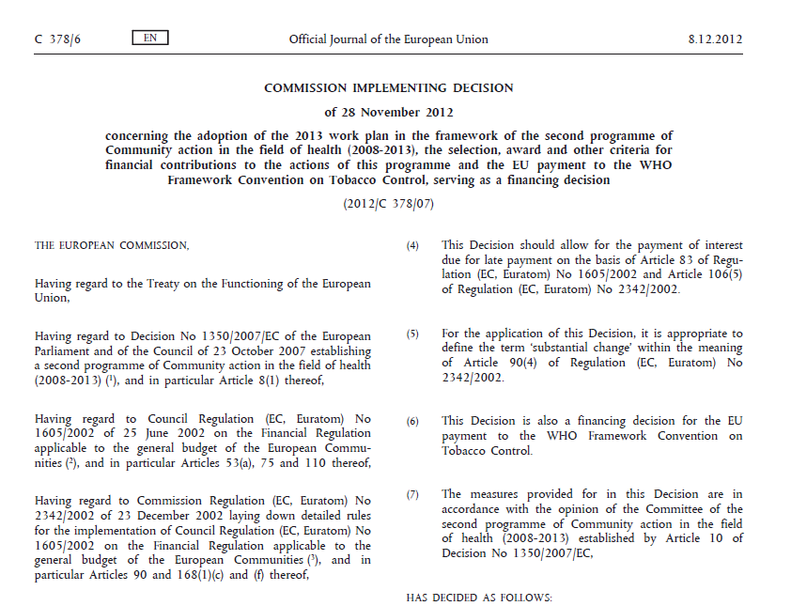
Workplan 2013

Slide 6
Structure Workplan
Commission Implementing Decision
Annex I:
  The workplan with legal context (1),
  Resources (2),
  Financing mechanisms (3),
  Priorities for 2013 (4)
Annex II: Criteria for Project Grants
Annex III: Criteria for Operating Grants
Annex IV: Criteria for Joint Actions
Annex V: Criteria for Conference Grants
Annex VI: Criteria for independence form industry (Joint Actions, Operating Grants)
Annex VII: Criteria for exceptional utility (co-financing up to 80%)

Slide 7
Budget 2012 vs. 2013
 | 2012 |  | 2013
Call for tenders | € 14.4 Mio. | 29% | € 13.3 Mio. | 26%
Project grants | € 13.1 Mio. | 27% | € 12.3 Mio. | 24%
Joint Actions | € 8.9 Mio. | 18% | € 13.8 Mio. | 27%
Operating grants | € 4.4 Mio. | 9% | € 5 Mio. | 10%
Conferences | € 0,8 Mio. | 2% | € 0.8 Mio. | 2%
International organisations | € 2.6 Mio. | 5% | € 1.2 Mio. | 2%
Other actions – JRC | € 5.2 Mio. | 11% | € 4.8 Mio. | 9%
Operating budget | € 49.6 Mio. | 100% | € 51.2 Mio. | 100%

Slide 8
Budget distribution 2012 vs. 2013

Slide 9
WORK PLAN 2013
Priorities by funding instrument

Slide 10
Joint Actions 2013

Slide 11
Priorities
4.1.4.1 Good practices on organ donation, collection, testing, processing, storage, and distribution of gametes for assisted reproductive technologies and haematopoietic stem cells for transplantation
(Indicative amount: EUR 1,0 M)
4.1.5.2 Facilitating collaboration among the Member States for effective operation of the pharmacovigilance system in the EU
(Indicative amount: EUR 3,3 M)
4.2.1.1 Adressing chronic diseases and promoting healthy ageing across the life cycle
(Indicative amount: EUR 5,0 M)
4.2.3.4 Joint Action to support Member States in taking forward work on common priorities in line with the EU alcohol strategy
(Indicative amount: EUR 1,5 M)
4.2.4.1 Development of a European guide on quality improvement in comprehensive cancer control
(Indicative amount: EUR 3,0 M)

Slide 12
4.1.4.1 Good practices on organ donation, collection, testing, processing, storage, and distribution of gametes for assisted reproductive technologies and haematopoietic stem cells for transplantation
seeks to develop and promote good practices on the donation, collection, testing, processing, storage and distribution of gametes for assisted reproductive technologies and haematopoietic stem cells for transplantation.
will develop guidelines to provide knowledge and guidance for actors in the field on the donation, collection, testing, processing, storage and distribution of gametes for assisted reproductive technologies. The aim is to ensure the safety and quality of different procedures in assisted reproductive technology establishments.
will develop guidelines to provide knowledge and guidance for actors in the field on the donation, collection, testing, processing, storage and distribution of haematopoietic stem cells for transplantation. The aim is to ensure the safety and quality of different procedures in bone marrow registers and in cord blood banks.
includes setting up a network of dedicated inspectors and authorities in each field, and providing training on good practices to authorities and actors in the field.
[Joint action] Indicative amount: EUR 1 000 000

Slide 13
4.1.5.2 Facilitating collaboration among the Member States for effective operation of the pharmacovigilance system in the EU
seeks to support Member States in achieving the optimal organisation and operation of the pharmacovigilance system in the EU and in fulfilling the requirements set out in Directive 2010/84/EU of the European Parliament and of the Council of 15 December 2010 amending, as regards pharmacovigilance, Directive 2001/83/EC on the Community code relating to medicinal products for human use .
will support Member States in finding ways to organise and run their pharmacovigilance systems in line with the EU pharmacovigilance legislation, focusing on:
(a) exchange of best practices by the Member States for the operation of an effective system to collect information on the suspected adverse reactions of medicinal products; (b) the allocation of resources and necessary expertise, including in the area of risk communication; (c) capacity building on evaluating quality systems to supervise pharmacovigilance activities; (d) developing a methodology to establish a link between the pharmacovigilance signals and possible medication errors, overdose, misuse and abuse, and follow-up to ensure patient safety; and (e) training on pharmacovigilance inspections and on the handling of the pharmacovigilance system master file with emphasis on multiplier effects, for example training of trainers.
[Joint action] Indicative amount: EUR 3 300 000

Slide 14
4.2.1.1 Adressing chronic diseases and promoting healthy ageing across the life cycle
addresses the challenge of the increased burden that chronic conditions and diseases place on the health systems and individuals, with a specific focus on multimorbidity.
It also responds to the priorities of the European Innovation Partnership on Active and Healthy Ageing, the Council conclusions on active ageing of 7 June 2010 ( 3 ), the Council conclusions ‘Innovative approaches for chronic diseases in public health and health care systems’ of 7 December 2010 and the reflection process on chronic diseases launched by the Member States and the Commission.
will develop a system for the collection, validation and dissemination of good practice focused on the prevention of chronic conditions and diseases along the life cycle with emphasis on innovative approaches to address major risk factors.
will use diabetes as a case study of a classic chronic disease and will focus on the barriers to prevention, screening and treatment and on how Member States can improve coordination and cooperation
will seek to develop common guidance and methodologies for care pathways for multimorbid patients
[Joint action] Indicative amount: EUR 5 000 000

Slide 15
4.2.3.4 Joint Action to support Member States in taking forward work on common priorities in line with the EU alcohol strategy
to support Member States in preventing harmful alcohol consumption and thereby improve the health of EU citizens and lessen the burden of ill health.
will contribute to the implementation of the EU alcohol strategy set out in Commission Communication COM(2006) 625 final of 24 October 2006 An EU strategy to support Member States in reducing alcohol related harm
provides an incentive for the Member States to intensify cooperation and develop common approaches
focuses on improving the monitoring of drinking habits and alcohol-related harm, and on good practice in the provision of information aiming to protect children and young people and to prevent alcohol-related harm among adults.
should result in: (a) a report providing comparable data on drinking habits and alcohol-related harm; (b) guidelines for low-risk alcohol consumption in order to protect children and young people and prevent harm among adults; and (c) a good practice toolkit of print and online instruments to disseminate low-risk drinking guidelines and other self-management tools.
[Joint action] Indicative amount: EUR 1 500 000

Slide 16
4.2.4.1 Development of a European guide on quality improvement in comprehensive cancer control
objective is to develop a European guide on quality improvement in comprehensive cancer control
should address various aspects of coordinated and integrated cancer control, including prevention, screening, diagnosis, treatment, follow-up, supportive care, palliative care, survivorship and research.
will contribute to reaching the aims of the European cancer partnership set out in Commission Communication COM(2009) 291 final of 24 June 2009 on Action against Cancer: European Partnership,
and will build both on its achievements and on the outcomes of previous EU action on cancer, such as the development of the fourth edition of the ‘European guidelines for quality assurance in breast cancer screening and diagnosis’, which includes a framework for comprehensive breast cancer services.
[Joint action] Indicative amount: EUR 3 000 000

Slide 17
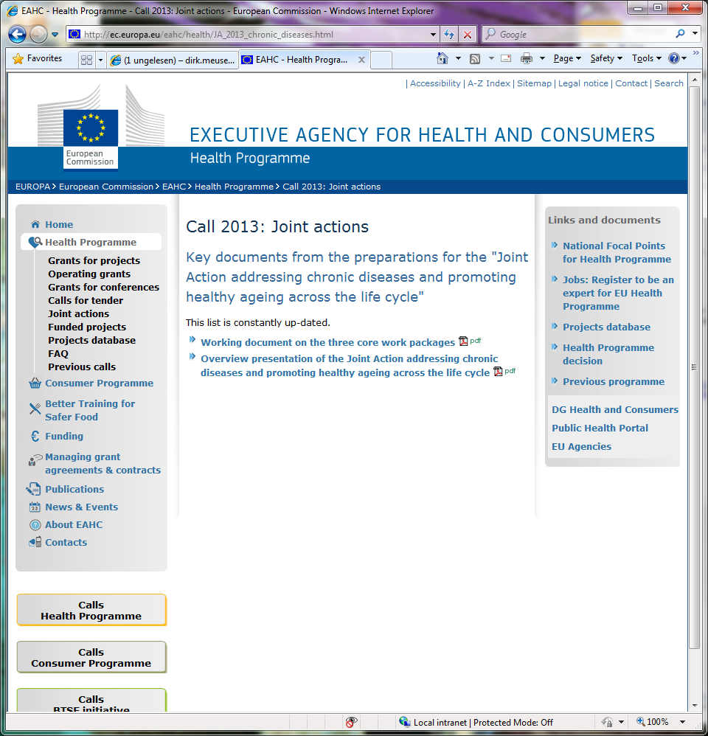
Joint Action specific pages

Slide 18
Participation Process
INTENTION LETTER (to SANCO/EAHC)
    Member States/other countries participating in the Health Programme that wish to participate in JA must declare their intention to the Commission
    Letter was send by SANCO to EU MS representations on 25 October 2012, with deadline for reply 16 November 2012
    The Intention letter must be sent to Commission to ensure participation in the preparatory meetings and to EAHC prior to the closure of the call
DESIGNATION LETTER (to the main beneficiary)
    If the Ministry of Health wants another body to represent their interest in the JA, they should expressly mandate this body by writing to the Main beneficiary a Designation Letter

Slide 19
Preparatory workshop
Aim: To inform representatives of organizations and institutions expected to participate in a Joint Action 2013
10-11 December 2012
http://ec.europa.eu/eahc/health/
Workshop_on_JA_2013.html

Slide 20
Quality assurance W/S
18- 19/02 2013 - Luxembourg
Aim: Improve the overall quality through a peer reviewing exercise (external experts) on a draft proposal.
Provide recommendations on:
  The technical content
  The project management quality
  The impact and implications of the action for EU public health
For main partner – scientific and administrative

Slide 21
Operating grants 2013

Slide 22
Operating Grants
can be awarded to
a non-governmental body or a specialised network, which:
  is non-profit-making and independent of industry, commercial and business or other conflicting interests,
  has members in at least half of the Member States,
  has a balanced geographical coverage,
  pursues as its primary goal one or more objectives of the Health programme,
Operating grants may be renewed
Maximum rate for EU co-financing is 60 % (80 % if a proposal meets the criteria for exceptional utility set out in Annex VII)

Slide 23
Operating Grants
grants can be awarded to
a non-governmental body or a specialised network, which:
  does not pursue general objectives directly or indirectly contrary to the policies of the EU and does not have an image harmful to the EU image,
  has provided to the Commission satisfactory accounts of its membership, internal rules and sources of funding,
  has provided to the Commission its annual work programme for the financial year and the most recent annual activity report and, if available, the most recent evaluation report,
  is not in any of the situations of exclusion listed in Articles 93(1) and 94 of the Financial Regulation.

Slide 24
Priority areas for Operating Grants
Work under operating grants should contribute to reaching the priorities of the European Union as set out in Commission Communication COM (2010)2020 of 3 March 2010 EUROPE 2020 — A Strategy for smart, sustainable and inclusive growth.
New operating grants may be awarded to non-governmental bodies and specialised networks active in areas corresponding to the three objectives of the Health programme
Annex VI contains the criteria for independence from industry, commercial and business or other conflicting interest.

Slide 25
CONFRENCE grants 2013

Slide 26
Conference Grants
Conference grants may be awarded for the organisation of conferences that correspond to the three objectives of the Health programme and should promote the priorities of the European Union as set out in Commission Communication COM (2010)2020 of 3 March 2010 EUROPE 2020— A Strategy for smart, sustainable and inclusive growth
Relevant issues include active and healthy ageing, sustainable health systems, health workforce, health threats and patient safety

Slide 27
New for conferences
Conferences can be submitted by one legal entity or by one legal entity and its affiliated entities

Slide 28
PROJECTS 2013
Six (6) separate calls

Slide 29
Priorities
Call 1: 4.1.1.1 - Improve access to early diagnosis of HIV/AIDS and timely treatment and care of most vulnerable groups and in priority regions (Indicative amount: EUR 1,5 M)
Call 2: 4.2.1.1 - Addressing chronic diseases and promoting healthy ageing across the life cycle (Indicative amount: EUR 1,0 M)
Call 3: 4.2.1.2 - Supporting the priorities of the European Innovation Partnership on Active and Healthy Ageing (Indicative amount: EUR 6,0 M)
Call 4 & 5: 4.2.2.7 - Pilot networks of cooperation under Directive 2011/24/EU "patients’ rights in cross-border healthcare"
  Pilot network of cooperation between paediatric oncology centres
  (Indicative amount: EUR 1,5M)
  Pilot network of cooperation between highly specialised neurology, clinical neurophysiology and neurosurgery centres
  (Indicative amount: EUR 1,5M)
Call 6: 4.2.4.5 - Support to an information network on lung mesothelioma (Indicative amount: EUR 0,83 M)

Slide 30
Call 1:
4.1.1.1 Improve access to early diagnosis of HIV/AIDS and timely treatment and care of most vulnerable groups and in priority regions
seeks to improve the early diagnosis of HIV/AIDS and provide timely treatment and care for vulnerable groups and in priority regions
reaching out to these groups with appropriate prevention, diagnosis and treatment is important to reduce the transmission of HIV/AIDS
will develop strategies to improve early diagnosis and to design tools for timely treatment for priority groups and regions
will look into how best to reach people in need of testing and treatment
will promote, disseminate and implement good practice guidelines and manuals in cooperation with health professionals, people living with HIV/AIDS and health and social service providers
supports the implementation of Commission Communication COM(2009) 569 final of 26 October 2009 Combating HIV/AIDS in the European Union and neighbouring countries, 2009-2013 (1), which puts particular emphasis on populations most at risk and priority regions.
[Project grants] Indicative amount: EUR 1 500 000

Slide 31
Call 2:
4.2.1.1 Addressing chronic diseases and promoting healthy ageing across the life cycle
In support of the joint action
will focus on the promotion of healthy lifestyles among the 65+ age group through the prevention of specific risks.
Unhealthy lifestyles and social isolation are key risk factors for chronic diseases and have an adverse impact on the health of older people.
should promote targeted innovative cost-effective health promotion approaches in older age groups.
[Project grants] Indicative amount: EUR 1 000 000

Slide 32
Call 3:
4.2.1.2 Supporting the priorities of the European Innovation Partnership on Active and Healthy Ageing
In support of the practical implementation of innovative solutions responding to the priorities of the European Innovation Partnership on Active and Healthy Ageing
will foster pilot actions at local and regional level focusing on the management of multimorbidity among elderly people through integrated care pathways as well as on improving adherence to treatment and prevention of falls and frailty
will group existing and planned public and private activities of excellence in order to create innovative, practical, feasible and measurable projects centred around:
implementation of integrated or coordinated interventions for early identification and diagnosis of physical frailty in older persons that can be preceded by multimorbidity and followed by the development of disability. Addressing frailty will meaningfully contribute to the development of personalised integrated care, facilitate coordination among professionals and reduce unnecessary use of health care resources;
implementation of interventions to address polypharmacy — lack of proper indications, inappropriate dosage and subclinical toxicities of medications. Current strategies include screening tools, but interventions which combine different health professionals and care settings through electronic monitoring could also be meaningful.
[Project grants] Indicative amount: EUR 6 000 000

Slide 33
Call 4 & 5:
4.2.2.7 Pilot networks of cooperation under Directive 2011/24/EU
Supports European reference networks, as provided for by Directive 2011/24/EU
will link health care providers and centres of expertise in the Member States.
to improve access to diagnosis and provide high-quality health care to patients who have conditions that require a particular concentration of resources or expertise, especially where the expertise is rare and case volume low.
Pilot network of cooperation between paediatric oncology centres: to implement and further develop the European standards of care for children with cancer.
[Project grant] Indicative amount: EUR 1 500 000
Pilot network of cooperation between highly specialised neurology, clinical neurophysiology and neurosurgery centres: to promote cooperation and to test and exchange standards and best practices on highly specialised and complex neurological and neurosurgical conditions, such as refractory epilepsy, severe craniofacial conditions, brachialis plexus injuries, refractory neuropathic pain, hereditary ataxia and paraplegia, multiple sclerosis and complex cerebro-vascular conditions.
[Project grant] Indicative amount: EUR 1 500 000

Slide 34
Call 6:
4.2.4.5 Support to an information network on lung mesothelioma
The aim of this action is to support the creation of an information network focusing on best practices for treatment of lung mesothelioma, which is becoming a rare disease owing to successful prevention efforts, and their dissemination.
The pooling of expertise is expected to contribute to reduce costs for individual health systems.
This action should exclude European Commission activities on the protection of workers from the risks related to exposure to asbestos at work.
[Project grant] Indicative amount: EUR 830 900

Slide 35
CallS for
PROPOSALS 2013

Slide 36
New Financial Regulation (FR)
Applicable from 01 January 2013
All grants: Change – from "negotiation" to "adjustment" – in the light of the recommendations of the evaluation committee
All grants: New "time to contract"

Slide 37
Time to grant - 2013
6 months
3 months
Information
to applicants
Legal
commitment
deadline

Slide 38
Time to grant – 2012
4 months
5-9 months
Deadline
Information
to applicants
Legal
commitment

Slide 39
Implications of "Time to contract"
The "financial identification form" has to be submitted by the applicant (main partner)
Declarations of honour have to be submitted as originals from all partners, not as copies
Legal entity forms (originals) have to be submitted for all partners
The following documents have to be submitted for all private partners:
  The official registration certificate of the association
  The organisation's status/articles of association
  Profit and loss accounts for the last 2 years for which the accounts are closed
  Balance sheet
  Financial viability form
Notes:
Also: updated Application forms.

Slide 40
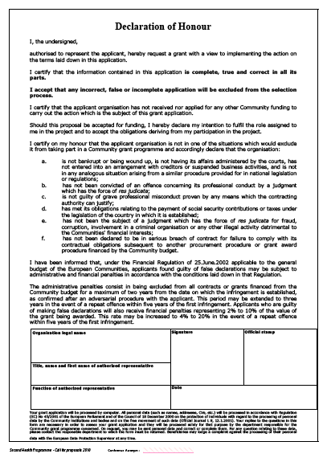
Declarations of Honour
Original of the Declaration of Honour, duly signed and stamped, is required from the main applicant
Original of the Declaration of Honour, duly signed and stamped, is required from the associated applicants

Slide 41
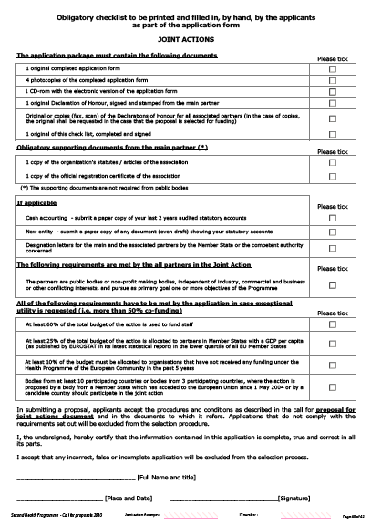
Obligatory checklist
Original of the obligatory checklist, duly ticked and signed, is required from the main applicant

Slide 42
New Financial Regulation (FR) –
Financial Changes
Low value grants with a EU contribution of
< 60 000 € (per beneficiary) are exempt from the no-profit rule
No financial guarantees will be requested for grants / beneficiaries asking for < 60 000€
Payment of pre-financing upon entry into force of the grant agreement instead of starting date.
Time limit for payments reduced from 90 to 60 days (for all instruments)
VAT is now eligible cost, except if deductible
Travel costs according to own rules, to upper limit of EC rules
Budget transfers between categories have no % limit as before
Exchange rates: average exchange rate used between the first day and the last day of the reporting period
No reporting on interest received on the pre-financing

Slide 43
Key documents
Application form (Adobe Reader 9.5 is required)
Decision establishing the second programme of Community action in the field of health 2008-2013
Annual work plan and its annexes
Call for proposals for projects
Guide for applicants – available soon
Model grant agreement
Financial Regulation and its implementing rules (http://ec.europa.eu/eahc/management/legislation.html)
All documents will be on the EAHC web-site once the Call is launched

Slide 44
Application Form
Generic Application Form | Specific Application Form
Improve access to early diagnosis of HIV/AIDS and timely treatment and care of most vulnerable groups and in priority regions | Application form for: pilot network of cooperation between paediatric oncology centres is to implement and further develop the European standards of care for children with cancer.
Addressing chronic diseases and promoting healthy ageing across the life cycle | Application form for: pilot network of cooperation between highly specialised neurology, clinical neurophysiology and neurosurgery centres
Supporting the priorities of the European Innovation Partnership on Active and Healthy Ageing | Application form for: support to an information network on lung mesothelioma

Slide 45
Timetable (Call for proposals)
Stages | Date/period
Publication of the call: | 20/12/2012
Deadline for submitting applications | 22/03/2013 (date of post stamp)
Evaluation period (indicative) | 25/03/2013 – 21/06/2013
Additional information request (completion of the application) | ≥ 06/2013
Information letter to applicants for adjustments to proposal | ≥ 07/2013 – 09/2013
Official letter (award decision) | ≤ 09/2013
Signature of grant agreement (indicative) | ≤ 12/2013
Starting date of the action (indicative) | ≥ 01/01/2014

Slide 46
Open Calls for Tenders

Slide 47
Priorities
4.2.2.1 Training packages for health professionals to improve access to and quality of health services for migrants and ethnic minorities
4.2.2.2 Support action on effective use of Cohesion and Structural Funds for health investments
4.2.2.4 Health Technology Assessment (HTA): early dialogue pilots on pharmaceuticals and medical devices
4.2.2.5 Overview of the legal framework for electronic health records in the Member States
4.2.2.6 Empowering patients in the management of chronic diseases
4.2.2.9 Review and mapping of the continuous professional development of health workers
4.3.3.4 Life-tabel analysis: Health system cost-effectiveness assessment across Member States
4.1.4.3 Good practices in the field of blood transfusion
4.2.3.3 Tobacco studies (Framework contract and 3-4 contracts)
4.3.3.1 Health Reports and Economic Analysis (Open Call for Framework Contracts)

Slide 48
4.2.2.1 Training packages for health professionals to improve access to and quality of health services for migrants and ethnic minorities
seeks to improve access to and quality of health services for migrants and ethnic minorities through improved training of health professionals
will develop training packages, pilot training and disseminate good practices
targets national authorities, providers of health services and organisations representing migrants and ethnic minorities
will review existing training material, identify gaps and needs, create core modules for new training material and adapt it to specific national contexts.
Piloting will be conducted in at least five countries participating in the programme
This action contributes to the implementation of Commission Communication COM(2009) 567 final of 20 October 2009 Solidarity in health: reducing health inequalities in the EU, which calls for EU-level action and professional training tools to address health inequalities through the health programme, ESF and other mechanisms. It also responds to the EU 2020 priority of reducing health inequalities to foster inclusive growth.
The indicative number of contracts envisaged is 1.
[Call for tenders]

Slide 49
4.2.2.2 Support action on effective use of Cohesion and Structural Funds for health investments
seeks to promote effective securing and use of funding for health by Member States and regions under the Structural Funds’ programming in the period 2014-2020, in order to enhance health systems’ effectiveness, quality and sustainability.
It responds to the Council conclusions: towards modern, responsible and sustainable health systems (2011/C 202/04) of 6 June 2011, and follows on from the work of the Health Systems Reflection Process Subgroup on the effective use of Structural Funds.
aims at building knowledge about the use of Structural Funds for health in the new programming period, disseminating this knowledge: and building expertise on Structural Funds, in particular among the health ministries and other relevant health bodies.
outcomes are expected to be: (a) mapping of the use of Structural Funds in health; (b) compilation of successful practices; and (c) a set of tools for achieving sustainable and effective investments in health, including health promotion and prevention of diseases, through the Structural Funds, for actors in the health sector and sectors impacting on health at national and regional level.
planned duration of the action is 18 months.
[Call for tenders/Framework contract]

Slide 50
4.2.2.4 Health Technology Assessment (HTA): early dialogue pilots on pharmaceuticals and medical devices
Directive 2011/24/EU sets up a voluntary network that connects national authorities or bodies responsible for health technology assessment to support and facilitate cooperation among Member States
contributes to such cooperation through the conduct of early dialogue pilots on pharmaceuticals and medical devices.
aim to facilitate the dialogue between industry and regulators, multiple HTA bodies and payers in the course of health technology development.
purpose is to ensure business predictability for industry as regards market access after market authorisation (MA) or CE licensing; rationalisation of requirements for various actors; complementarity with the scientific advice provided by the European Medicines Agency; and preparation of post MA or CE marking requirements.
aims to conduct up to 10 early dialogue pilots.
In addition, it responds to the Council conclusions on innovation in the medical devices sector (2011/C 202/03).
The indicative number of contracts envisaged is 1.
[Call for tenders]

Slide 51
4.2.2.5 Overview of the legal framework for electronic healht records in the Member States
The eHealth network is working towards interoperability guidelines for eHealth providing a framework at legal, organisational, semantic and technical levels.
aims to enhance and secure seamless eHealth services at European level, covering the electronic exchange of patient summary sets of data, ePrescription and eIdentification for health, thereby ensuring the safety and continuity of cross-border health care for citizens.
Results of ‘European Patients Smart Open Services’ (EPSOS) project on cross-border eHealth services has demonstrated that one of the key barriers to the sustainability of piloted eHealth services is the legal interoperability challenge.
expected outcome of this action is a study that will examine in detail and provide an overview of the regulatory frameworks at national level on electronic health records (EHR) and provide recommendations to facilitate the work of the eHealth network on the legal layer of eHealth interoperability.
The indicative number of contracts envisaged is 1.
[Call for tenders]

Slide 52
4.2.2.6 Empowering patients in the management of chronic diseases
seeks to help understand the concept of patient empowerment and identify inherent advantages and barriers through detailed mapping of existing initiatives in the self-management of chronic diseases.
Patient empowerment is a core value of a modern patient-centred health system, as advocated by the Council conclusions on common values and principles in European Union health systems (2006/C 146/01).
should result in: (a) a catalogue of successful patient empowerment strategies and actions; (b) identification of barriers to and advantages of patient empowerment; (c) a method to validate transferability of good practices on patient empowerment; and (d) scenarios of EU collaboration on patient empowerment.
estimated time frame for delivery of the resulting study is mid-2014.
outcomes will feed into the chronic disease reflection process based on the Council conclusions ‘Innovative approaches for chronic diseases in public health and health care systems’, with the aim of facilitating the provision of high-quality and sustainable health care.
The indicative number of contracts envisaged is 1.
[Call for tenders]

Slide 53
4.2.2.9 Review and mapping of hte continuous professional development of health workers
seeks to review and map the continuous professional development of health workers
Given growing concerns about shortages of skilled health professionals and with demographic change increasing the demand for services, Member States have to find ways to ensure sustainability of their health workforce.
As highlighted in the action plan for the EU health workforce, access to lifelong learning and continuous professional development (CPD) plays an important role in keeping professional skills up to date, ensuring quality of care and also as a means to motivate and retain staff. CPD systems and regulations vary significantly across the EU and country-specific data remain scarce.
will review and map national systems, governance and practices in place to ensure the continuous professional development of health workers with the aim of promoting good practice.
concluding workshop with national experts and professional organisations will also be organised.
The indicative number of contracts envisaged is 1.
[Call for tenders]

Slide 54
4.3.3.4 Life-tabel analysis: Health system cost-effectiveness assessment across Member States
seeks to provide a health system cost-effectiveness assessment across Member States
aims to disentangle some of the complexities inherent to health system performance measurements at population level
responds to the Council conclusions of 6 June 2011 on moving towards modern, responsive and sustainable health systems, which invited the Member States and the Commission to cooperate in measuring and monitoring the effectiveness of health investments
The indicative number of contracts envisaged is 1.
[Call for tenders]

Slide 55
4.1.4.3 Good practices in the field of blood transfusion
objective of this action is to ensure the efficient use of blood and blood components and to help hospitals reach self- sufficiency therein through the implementation of best practices.
This action will: (a) develop a guide on the criteria, parameters and material for the implementation of best practices and for the evaluation of the process; (b) develop a Web-portal as a forum for the exchange of best practices and national outcomes and consultation; (c) establish a network of benchmark hospitals in the EU on efficient blood transfusion management; and (d) develop a training programme for trainers.
This action will help Member States comply with the requirements of Directive 2002/98/EC.
The indicative number of contracts envisaged is 1.
[Call for tenders]

Slide 56
4.2.3.3 Tobacco studies
objective of this action is to gather information and knowledge to support EU tobacco control policies in general, and tobacco product regulation in particular, with emphasis on the implementation of Directive 2001/37/EC of the European Parliament and of the Council of 5 June 2001 on the approximation of the laws, regulations and administrative provisions of the Member States concerning the manufacture, presentation and sale of tobacco products ( 1 ), in its current or future form. This action has three work packages.
1 work package concerns tracking and tracing with the aim being to analyse, describe and possibly help design the standards for a system that will ensure full traceability of tobacco products and of security features allowing the identification of ‘genuine’ products.
1 work package concerns the role of additives and packaging in determining consumer preferences
1 work package concerns the further development of labelling standards for tobacco product packages
The indicative number of contracts envisaged is 3-4.
[Call for tenders]

Slide 57
4.3.3.1 Health Reports and Economic Analysis
objective of this action is to produce information, in the form of reports and economic analysis, which is needed at short notice to support the development or implementation of policies or legislation and the evaluation of the effects of policy implementation.
Health reports ought to provide well-structured and sound information on topical issues for EU citizens, stakeholders and policy-makers.
Economic analysis will provide information on health and health-related phenomena serving as sound evidence for policy-making.
The indicative number of contracts envisaged is 1-4.
[Call for tenders – Framework contract]

Slide 58
Timetable (Open call for tenders)
Stages | Date/period
1st Call | Spring 2013
Evaluation | Summer 2013
Official letter (award decision) | Summer 2013
Signature of grant agreement (indicative) and Starting date of the action (indicative) | Summer/Autumn 2013
2nd Call | Summer 2013
Evaluation | Autumn 2013
Official letter (award decision) | Autumn 2013
Signature of grant agreement (indicative) and Starting date of the action (indicative) | Autumn/Winter 2013

Slide 59
Receive alert
If you wish to be informed when calls for tenders are published, please register with EAHC writing an e-mail to:
EAHC-HP-TENDER@ec.europa.eu
with subject line:
"please put me on the mailing list".

Slide 60
Further Info

Slide 61
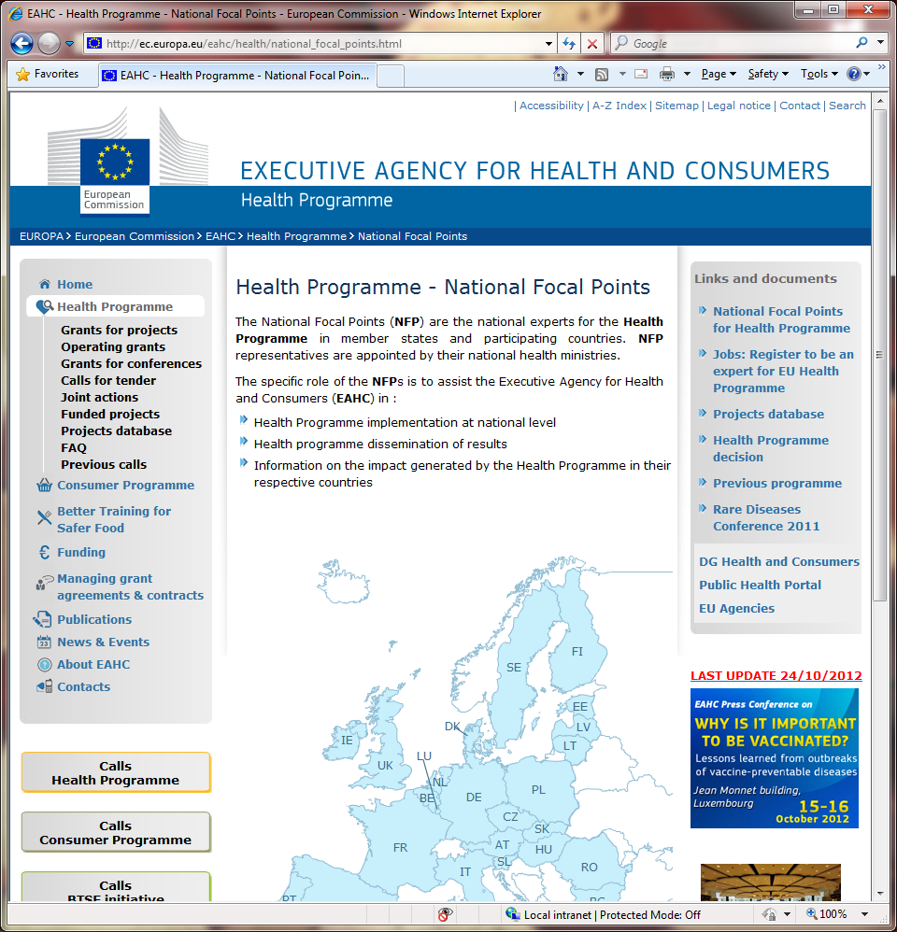
National Focal Points

Slide 62
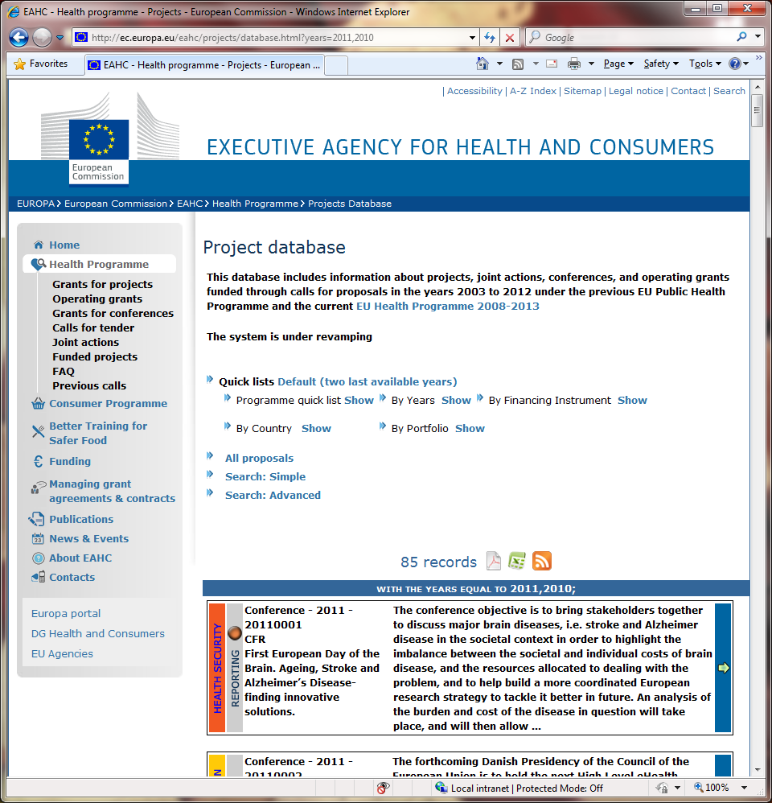
Project Database

Slide 63

Experts for evaluation

Slide 64
Thank you!
Georgios Margetidis
Scientific Project Officer
European Commission
Executive Agency for Health and Consumers
Health Unit
+352 4301 37228
georgios.margetidis@ec.europa.eu
http://ec.europa.eu/eahc/

