Slide 1
Financial management of grants
National Information day
23 July 2015
Greece

Slide 2
Table of Contents
General information
Provisions of grant agreement

Slide 3
1. General Information

Slide 4
Legislative context
Financial Regulation (FR) applicable to the general budget of the Union (EU, Euratom) No 966/2012
  Title VI Grants
Rules of Application (RA) - Interpretation of the Financial Regulation, No 1268/2012
In force since January 2013.
Consolidated version of the above regulations are available: http://europa.eu/pol/financ/index_en.htm or http://europa.eu/eu-law/legislation/index_en.htm

Slide 5
Principles
Definition: a grant is a direct financial contribution to an action or functioning of a body
Co-funding rule: external co-financing from a source other than EC funds is required (own resources or financial contributions from third parties, project income)
Non-profit rule: the grant may not have the purpose or effect of producing a profit for the beneficiary
Non-retroactivity rule: only costs incurred after the starting date stipulated in the grant agreement can be co-funded
Non-cumulative rule: only one grant can be awarded for a specific action carried out by a given beneficiary

Slide 6
2. Provisions of the grant agreement

Slide 7
Duration – Article 3 / Article 6.1 / Article 15:
Indicates the duration (number of months) and the starting date of the action (fixed date or first day of the month following the signature).
Costs are eligible within the duration of the action.
Costs until 60 days after the end of the action can be eligible if they are directly and only linked to the completion of the final reports – i.e. staff costs, editing - printing the report etc.

Slide 8
Estimated budget – Article 4 / Article 5.2 / Annex 2:
Summarizes the estimated costs and estimated receipts of the action per partner (and its affiliated entities, if any) and per budget category as presented in Annex 2.
Article 4:
  Reference to Annex 2
  Budget transfers – no amendment is necessary, except for new subcontracting items which are not foreseen in Annex 1.
Article 5.2: contains the total amount of estimated costs

Slide 9
Grant amount, Form of grant – Article 5, Annex 2:
“Maximum EU Contribution” (in Annex 2, column g): only a “theoretical” amount, it is the application of the reimbursement rate over the total estimated costs.
“Maximum grant amount” (in Article 5.1 and Annex 2, column h): the maximum amount the Agency will pay as contribution to the action’s costs. In most cases it is equal to "Maximum EU Contribution", but can be lower.
“Final grant amount” (Article 5.3): equals to or is lower than the maximum grant amount. Established at the balance payment and based on actual eligible costs reported according to article 15 in the template of Annex 4.

Slide 10
Form of grant – Article 5.2
Grant = partial reimbursement of costs that are actually incurred by beneficiaries of the grant agreement at the fixed reimbursement rate. Costs are assessed at the time of the periodic reports (interim and balance payments).
Grant amount is assessed at project level, allocation of the grant among beneficiaries is an internal agreement of the project consortium.
Double-ceiling of the grant: maximum grant amount compared to the result of reimbursement rate applied to the consolidated total eligible costs of the action
  In case of over-expenditure – maximum amount is paid
  In case under-expenditure – reimbursement % is applied

Slide 11
Eligible costs – Article 6.1
General conditions - Cumulative requirements:
Connected with the action as described in Annex 1 and included in the Estimated Budget (Annex 2);
Necessary for the implementation of the action;
Reasonable and justified - “good housekeeping”;
Incurred during the period of Article 3;
Actually incurred by the beneficiaries of the grant;
Identifiable and verifiable, in particular being recorded in the accounting records of beneficiary in accordance with accounting standards and the beneficiary’ accounting practices.

Slide 12
Ineligible costs – Article 6.4 / Article 26
Return on capital;
Debt and debt service charges, Interest owed, doubtful debts;
Provisions for future losses;
Bank costs charged by the beneficiary's bank for transfers from the
Agency;
Currency exchange losses;
Costs declared by a beneficiary and covered by another action funded
by an EU grant (particular attention to operating grants);
Contributions in kind provided by 3rd parties;
Deductible VAT;
Excessive or reckless expenditure;
Costs incurred during suspension of the implementation of the action.

Slide 13
Non Deductible VAT – ELIGIBLE
The revised Financial Regulation, provides for the full eligibility of the cost of VAT when:
attributable to exempt activities;
activities out of the scope of VAT.
In other words, non-deductible VAT is eligible as expenditure, save for those activities matching the concept of sovereign powers exercised by Member States.

Slide 14
Direct Costs - as actually incurred by the beneficiaries
Forms of costs – Article 5.2 / Article 6.2
Direct personnel costs
Subcontracting
Other direct costs
  Travel costs and subsistence allowances
  Equipment
  Other goods and services
Indirect Costs
4. Flat rate of 7% of total direct costs

Slide 15
Personnel costs – Article 6.2.
Staff = employment contract or equivalent appointing act with one of the beneficiaries.
  Costs claimed: salary + social security + taxes;
  Any other costs included in the remuneration (= statutory charges) based on national law or employment contracts;
  Additional remuneration, if it is part of beneficiary's usual practices, objective and generally applied regardless of sources of funding.
Considered as personnel costs
  Costs of natural persons working under a direct contract with the beneficiary other than employment (on the beneficiary's premises, results belong to the beneficiary with similar costs of employment)
  Costs of personnel seconded by a third party against payment
No differentiation on status of public / non-public officials.

Slide 16
Subcontracting – Article 6.2 / Article 10
Contracts awarded to cover the execution of a limited part of the action / tasks.
  Part of activities undertaken by the project
  Service contracts
  Invoices (including taxes, charges, travel & subsistence costs)
Core elements and technical / financial management of the action cannot be subcontracted;
Tasks subcontracted must be clearly set out in Annex 1;
Requirement of transparency, best value for money and, if appropriate, lowest price. Conflict of interest must be avoided;
Documents of procedures applied must be available.

Slide 17
Travel and subsistence – Article 6.2
Travel & subsistence incurred as costs by the beneficiary for all participants, except subcontractors shall be claimed here:
  Personnel
  Collaborating stakeholders
  Invited experts, speakers
  Board members
  Trainees, other participants
Costs should be in line with the beneficiary's usual practice and rules on travel and subsistence.

Slide 18
Equipment – Article 6.2
Specific equipment (software, PC, laptop, fee for licence, etc.) necessary for the action
Costs eligible:
  Portion of equipment's depreciation costs only, for the period of the action, if recorded in the beneficiary's accounts. Purchase and depreciation is in accordance with international accounting principles and the beneficiary's usual accounting practices.
  Costs of renting equipment
  Cost of leasing equipment (excluding financing costs)
Common software (Microsoft Office, Excel, Word,) are part of Indirect Costs

Slide 19
Other goods and services – Article 6.2 / Article 9 / Article 16.9
Must be directly linked to the action
Requirement of transparency, best value for money and, if appropriate, lowest price. Conflict of interest must be avoided.
Examples
  Dissemination of information;
  Specific evaluation of the action;
  Certificates of financial statements;
  Translations, reproduction of reports;
  Consumables and supplies (excluding general office supply);
  Conference fees, costs related to meetings / events;
  Bank charges (please refer to Article 16.9);
  Cost of financial guarantee, if applicable.

Slide 20
Affiliated entities – Article 6.3 / Article 11
Have a link (legal / capital) with one of the beneficiaries
They may implement the action tasks attributed to them:
  They must be listed as linked to a beneficiary in the grant agreement
  They may declare as eligible the costs they incur for implementing the action tasks in accordance with grant eligibility criteria/conditions
  They do NOT sign the grant agreement
Beneficiaries must ensure that their obligations under the grant agreement also apply to their affiliated entities.

Slide 21
Currency, conversion into EURO – Article 15.5
Financial statements must be drafted in EURO.
Beneficiaries with accounting established in another currency must converts costs at the average of the daily exchange rates published in the Official Journal of the EU calculated over the corresponding reporting period.
  In practice average of exchange rates for currencies concerned are on ECB website – instructions in the following slides
  https://www.ecb.europa.eu/stats/exchange/eurofxref/html/index.en.html
Beneficiaries with accounts established in euro must convert costs incurred in another currency into euro according their usual accounting policies.

Slide 22
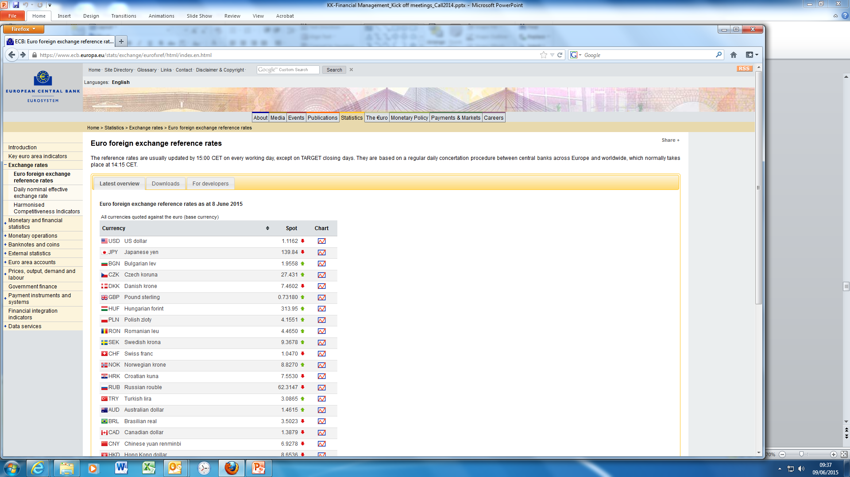
Select currency then click on "chart"

Slide 23
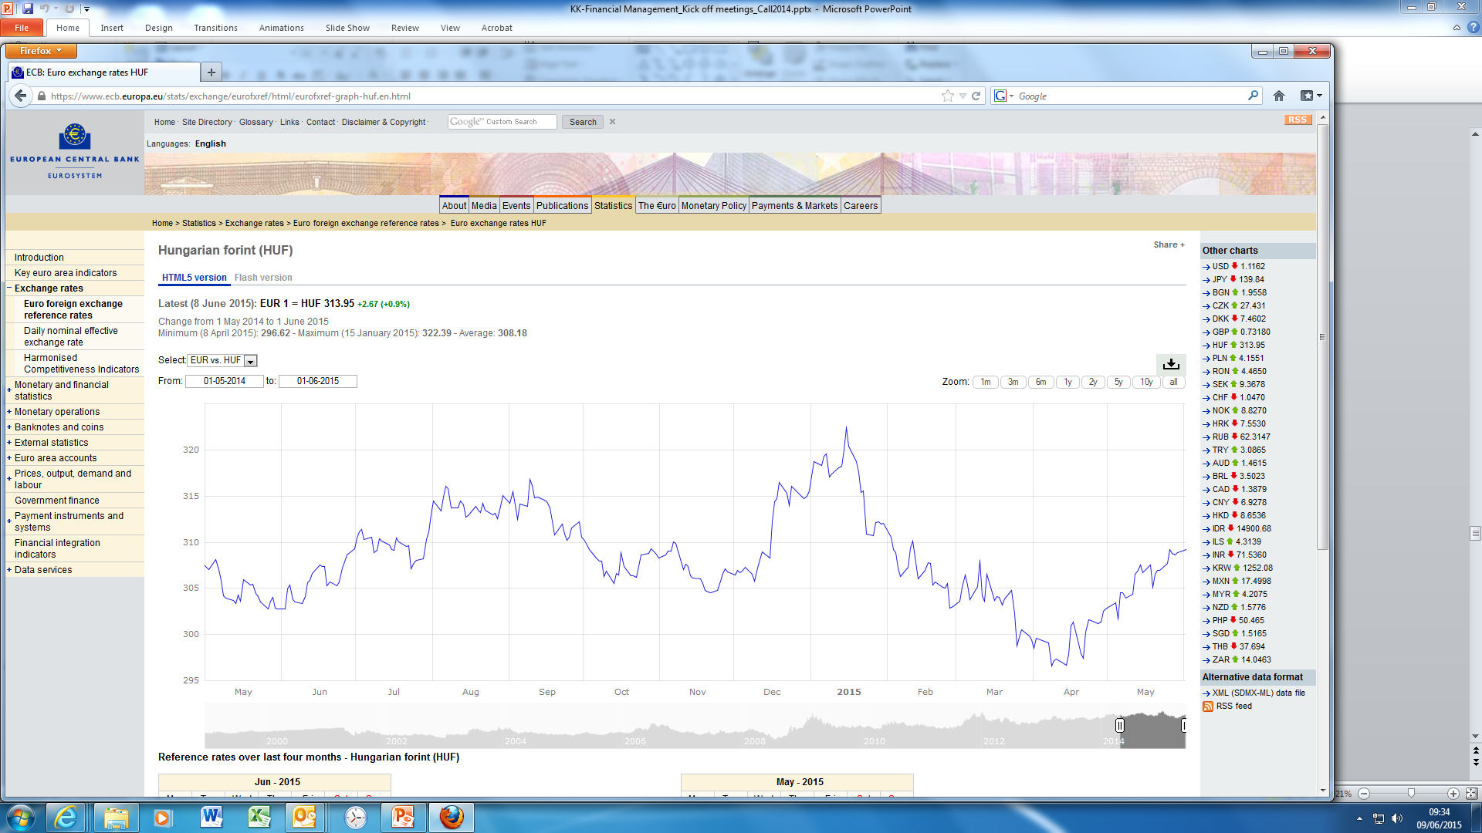
Average for the reporting period
Enter reporting period

Slide 24
Records, supporting documents – Article 13
Keep all records and supporting documents for a period of 5 years after the final payment in order to prove proper implementation of the action!
Beneficiaries must keep the original documents. Digital and digitalized documents are accepted in accordance with the national law.
Records and supporting documents must be made available in the context of checks, reviews, audits and investigations.

Slide 25
Supporting documents of the costs declared
All activities generating costs must fall within the duration
  Events, meetings, delivery of consumables, services etc.
  +60 days: activities directly linked to preparation of the final report
All debts must be established by the time the final report is submitted to the Agency
  Date of invoices and payments can be outside the duration
  Prior the duration (e.g. equipment, kick-off meeting)
  After the duration (e.g. service contracts, final conference)
Type of supporting documents
  Timesheets, salary slips, invoices, contracts, purchase orders, acknowledgments of receipts / delivery, participants lists, documents of procurement procedures for subcontracting
  The amounts of cost items must be accurately established from the supporting documents and reconciled to the accounting records.

Slide 26
Amendment – Article 34 / Article 39 / Article 40
The Grant Agreement may be amended
  If it does not call into question the decision awarding the grant
  If it does not breach the principle of equal treatment of applicants
  Amendments may be requested by any of the parties. The requests of the beneficiaries must be submitted by the coordinator to the Agency via the new IT tool.
  Several amendments can be requested in parallel to address the different changes.
Change of legal representative or any other administrative details (name, address, legal form) are done directly into the IT system.
Budget adjustements do not require formal amendment, except introducing new items under subcontracting.

Slide 27
Cases, when amendment is necessary:
Beneficiary terminates its participation and leaves the consortium;
New beneficiary joins the project consortium;
Affiliated entity is added by any of the beneficiaries;
Change / extension of duration;
Change of Annex 1 – description of the action (without changing the scope of the action);
Addition of new subcontracting item;
Change of reporting scheme.

Slide 28
Periodic Financial Report – Article 15.3
Prepared for each reporting period!
Individual financial statement from each beneficiary [and each affiliated entity, if any]. It must detail actual costs incurred for the reporting period concerned.
  Template to be used: Annex 4
All eligible costs must be declared, even if they exceed the amounts indicated in the estimated budget. Amounts which are not declared in the individual financial statement will not be taken into account by the Agency for the payment calculation.
If an individual financial statement is not submitted for a reporting period, it may be included in the periodic report for the next reporting period.
The individual financial statements of the last reporting period must also detail the receipts of the action.

Slide 29
Request for payment of the balance and Final Financial Report - Article 15.4:
In addition to the documents of the last reporting period:
Final summary financial statement created by the system automatically, consolidating the individual financial statements for all reporting periods and including the request for payment of the balance
  Template to be used: Annex 4
A certificate on the financial statements for each beneficiary [and each affiliated entity], if it requests a contribution of EUR 325 000 or more, as reimbursement of actual costs and the total grant as reimbursement of actual costs is EUR 750.000 or more.
  Template to be used: Annex 5

Slide 30
Payments – Article 16
Pre-financing payment - Article 16.2, Annex 3
  It provides beneficiaries with a float. It remains the property of the EU until the balance payment.
  It will be distributed by the coordinator as soon as 90% of the beneficiaries sign the accession form (Annex 3) and to only those beneficiaries who have signed it.
Interim Payment – Article 16.3
  Approval of periodic report(s) + corresponding deliverables (via IT system);
  Payment is based on actual costs incurred during the reporting period and approved by the Agency;
  Total amount of pre-financing and interim payment(s) is limited to 90% of the maximum grant amount;
  Receipts of the action are not considered at this stage.

Slide 31
Balance Payment – Article 16.4
  Reimburses the remaining part of the eligible costs for the implementation of the action.
  Approval of final report + corresponding deliverables (via IT system)
  Establishment of the consolidated total eligible costs created automatically by the system from the periodic reports of the action
  Determination of the final grant amount, please refer to slides "Final grant amount – Article 5".
  Calculations are made at project / joint action level, allocation of the grant among beneficiaries is based on consortium agreement.
  Amount due is the balance of the final grant after the deduction of pre-financing and interim payments.
  The balance is a recovery, if the amount of earlier payments exceeds the final grant amount.

Slide 32
Final grant amount - Article 5.3
Established at the time of balance payment
4 steps to calculate – will be made by the IT system
Apply the reimbursement rate defined in the grant agreement,
Article 5.2 over the total eligible costs as declared by the beneficiaries and approved by the Agency.
Limit to the maximum grant amount:
  Compare the result of step 1 with the maximum grant amount defined in the grant agreement, Article 5.1
  The final grant amount will be limited to the lower amount.

Slide 33
Application of no-profit principle – is it possible to pay the result of step 2?
  Profit is generated when the sum of the grant amount (result of step 2) and the action's total receipts is higher than the action's total accepted eligible costs (serving as a basis for step 1).
  Check:
  Has the action generated any income?
  Is there any third party contribution?
  If yes, calculate the sum (a + b) and add it to the result of step 2.
  Compare result of step 3 to the amount of eligible costs
  If step 3 > eligible costs – the action would generate profit and the final grant amount should be adjusted in proportion of the reimbursement rate.
Reduction due to improper implementation of the action

Slide 34
Checks, Reviews, Audits, Investigations - Article 17
Checks — during the implementation of the action or afterwards —any aspect relating to the grant, including the assessment of deliverables and reports.
Reviews — at any moment and up until 2 years after the payment of the balance
  Reviews concern mainly the technical implementation of the action, but may also cover financial aspects or compliance with other obligations under the GA.
Audits — at any moment and up until 2 years after the payment of the balance. Rights to access for the European Court of Auditors.
Investigations — by the European Anti-Fraud Office to establish whether there has been fraud, corruption or other illegal activity.
The Agency may be assisted by external experts or auditors.

Slide 35
Read the grant agreement and the guidelines
Involve your HR, Accounting and Procurement
  HR department – who is staff, components of salary
  Accounting – must have all available financial information and supporting documents
  Procurement / Sourcing – contract management with third parties, applicable procedures
Collect supporting documents systematically from Day 1
Collect currency exchange rates from Day 1
Establish project website (communication, reporting, document sharing, monitoring, etc.)
Project manager at the coordinator (and WP leaders, if necessary), Financial officer at the coordinator
Contact your project officer at the Agency

Slide 36
Thank you for your attention!
Questions?

