Slide 1
3rd Health Programme 2014-2020
The Electronic Submission System (JA 2015)
Georgios MARGETIDIS
Scientific Project Officer
Athens, 21 April 2016

Slide 2
Electronic submission of
Joint Action proposals
3

Slide 3
New system = new terminology
The ECAS account is the European Commission's Authentication Service. It is the system for logging on to a whole range of websites and online services run by the Commission.
The Beneficiary Register is the European Commission's online register of the beneficiaries participating in EU Programmes, such as Horizon 2020 programmes, the Health and Consumers Programmes and others.

Slide 4
New system = new terminology
The Participant Identification Code (PIC number) is a 9-digit participant identification code, received upon completing the registration of the entity online.
The LEAR (Legal Entity Appointed Representative) is the appointed representative within the beneficiary organisation to manage its data in the Electronic Submission System.

Slide 5
How will it work!
Submitting an application is only possible online via the Electronic Submission Service.
Proposals need to be submitted BEFORE the deadline: 02 June 2016
A link to the Electronic Submission System will be sent to each Joint Action coordinator after their nominations.

Slide 6
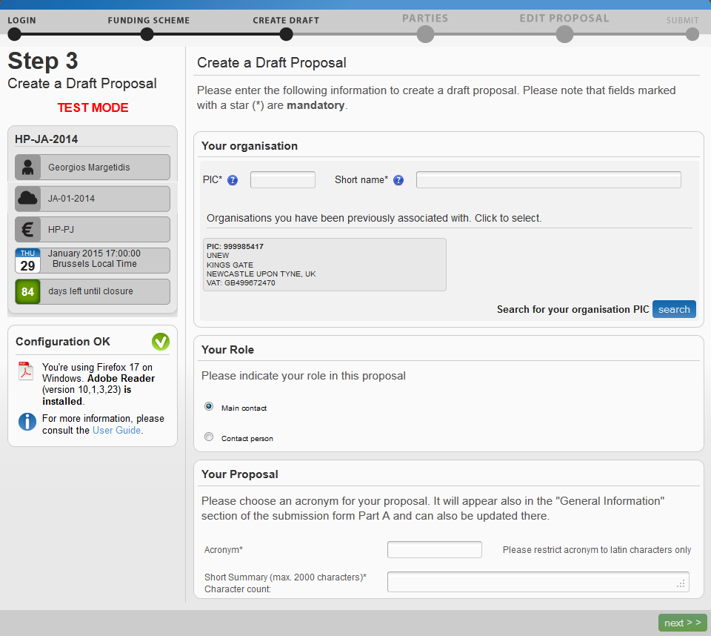
Search your PIC

Slide 7
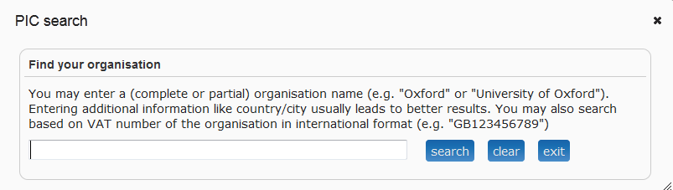

Slide 8
If your organisation is not in the system
You need to first create a user account (European Commission Authentication System).
You can then proceed to register your organisation through the European Commission’s Beneficiary Register.
To complete this registration process, you will need to provide information about your entity legal status and its finances.

Slide 9
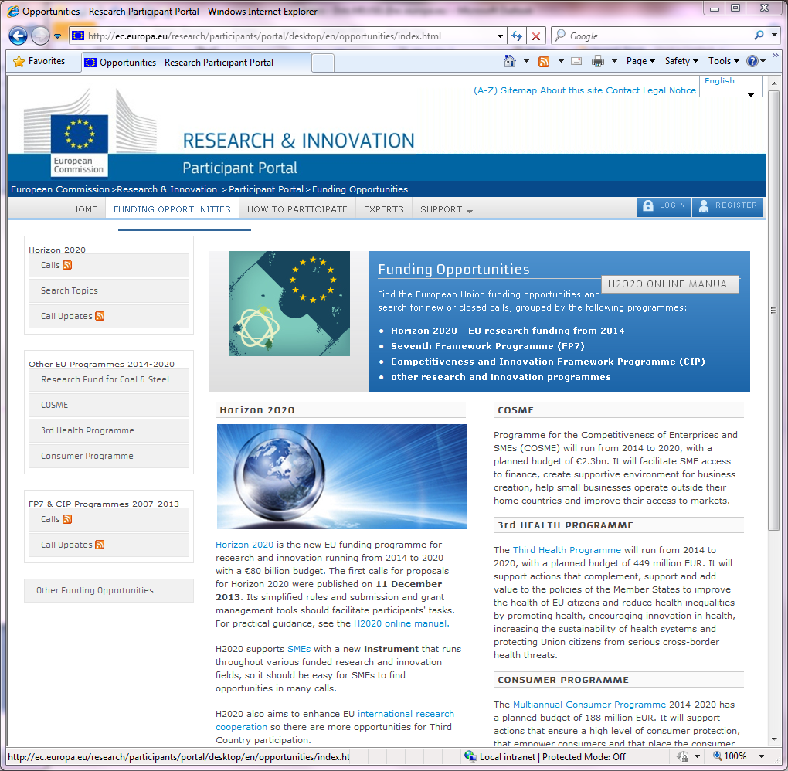
Login with or register for an ECAS account
ECAS registration/ login

Slide 10
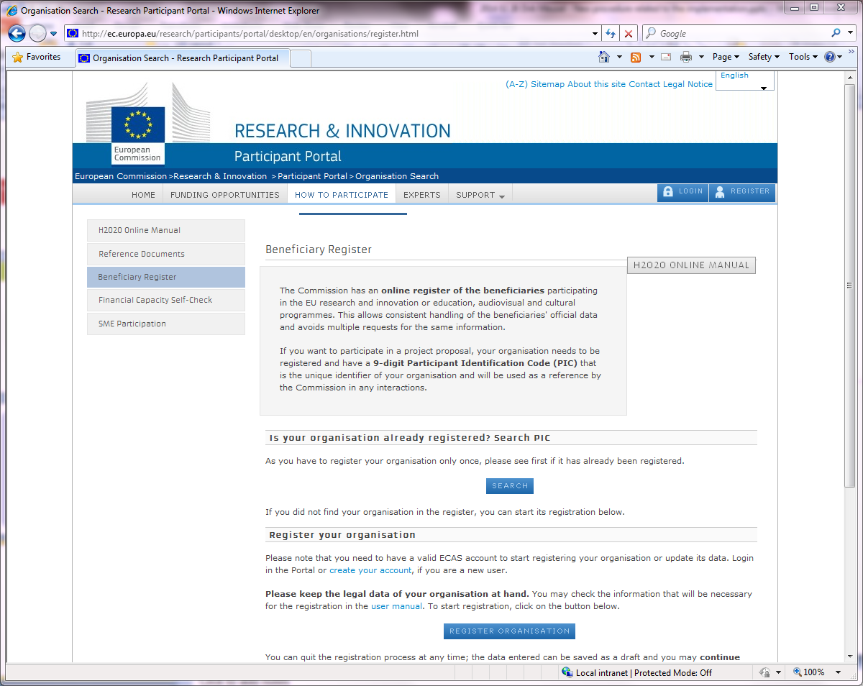
Make sure, you and your partners' organisations are registered.
http://ec.europa.eu/research/participants/portal/desktop/en/ organisations/register.html
Legal Entity
Registration

Slide 11
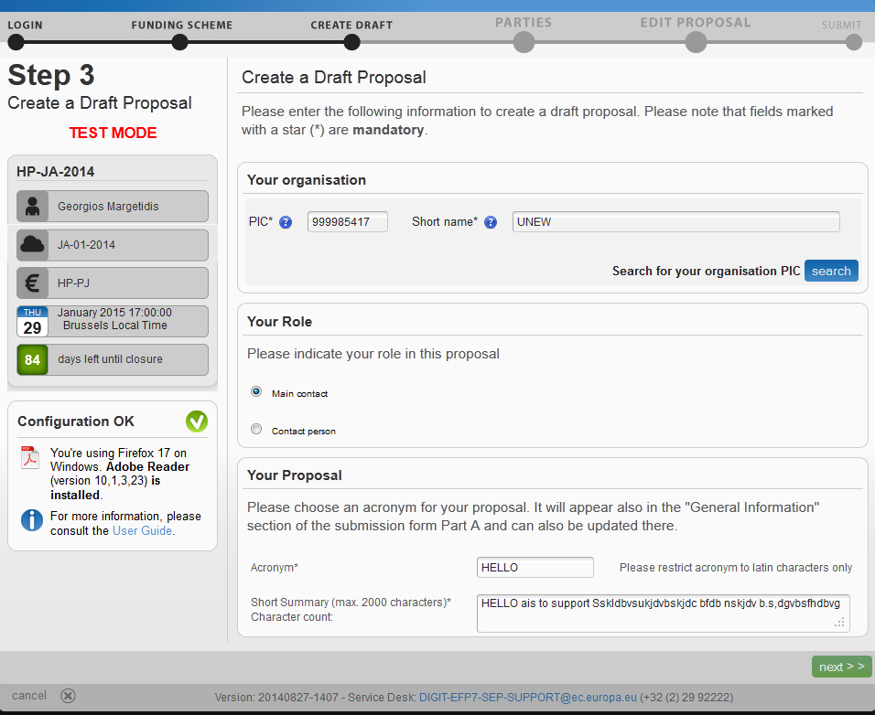
Put Acronym and Summary
Next

Slide 12
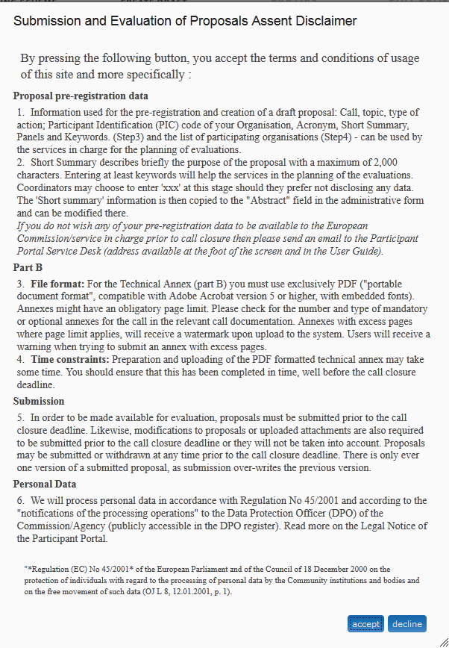
Accepting creates draft proposal

Slide 13
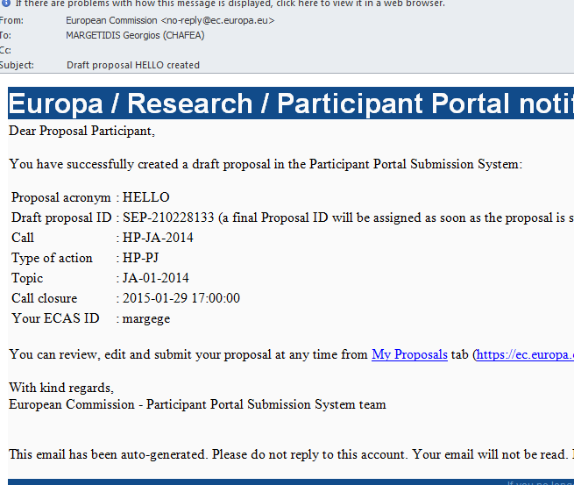
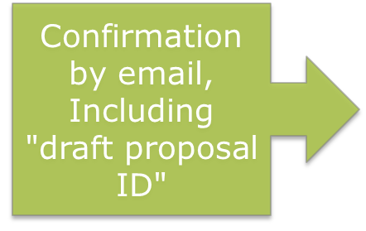

Slide 14
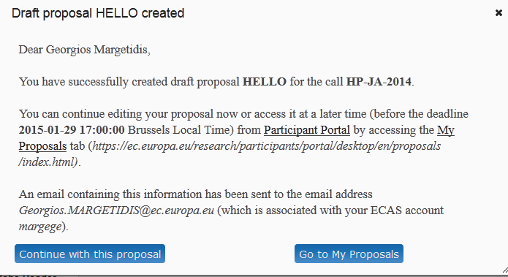
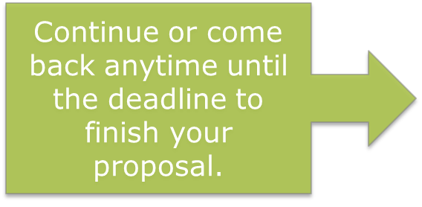

Slide 15
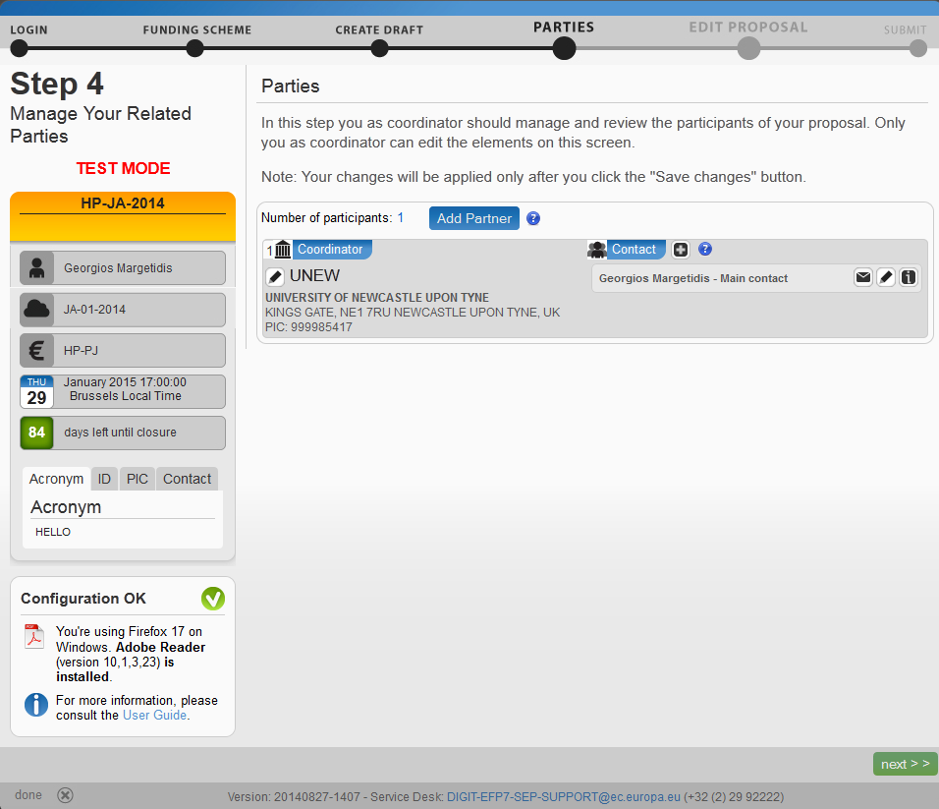

Slide 16
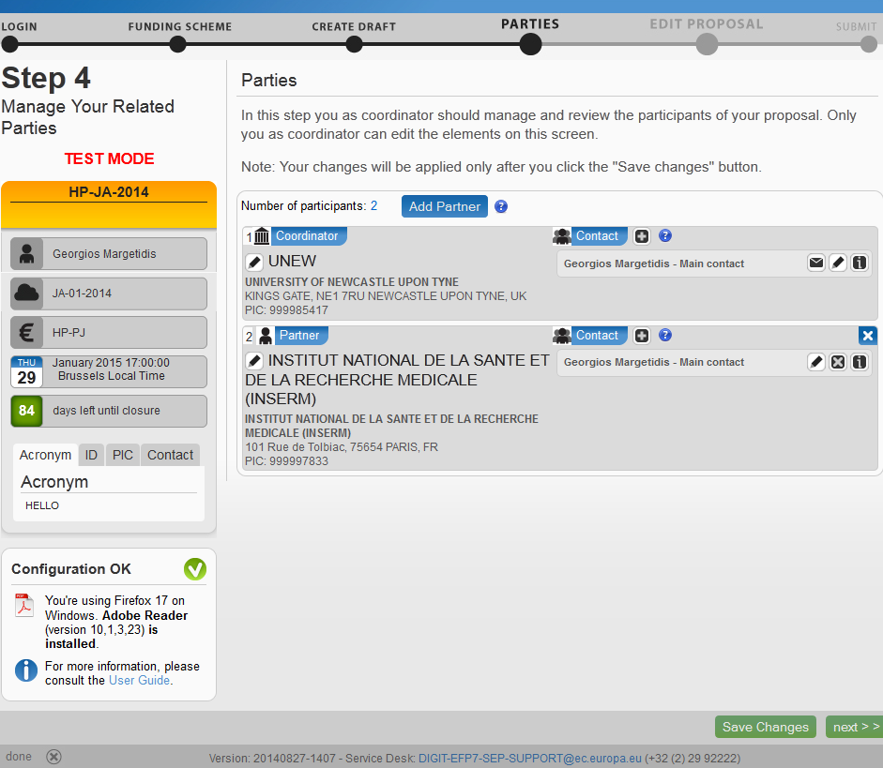

Slide 17
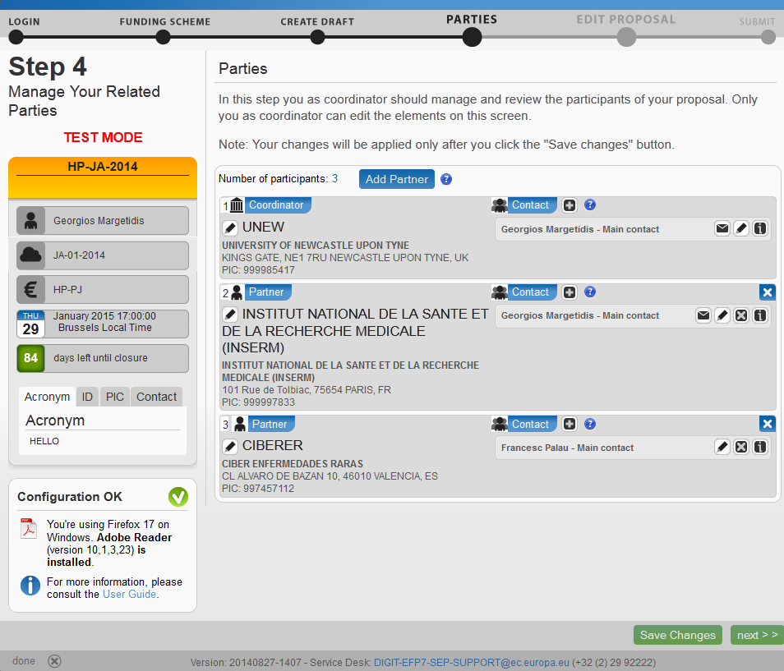

Slide 18
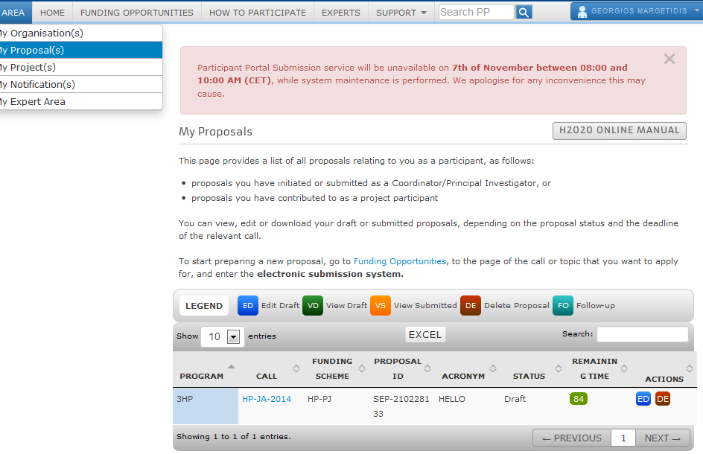
Edit or Delete

Slide 19
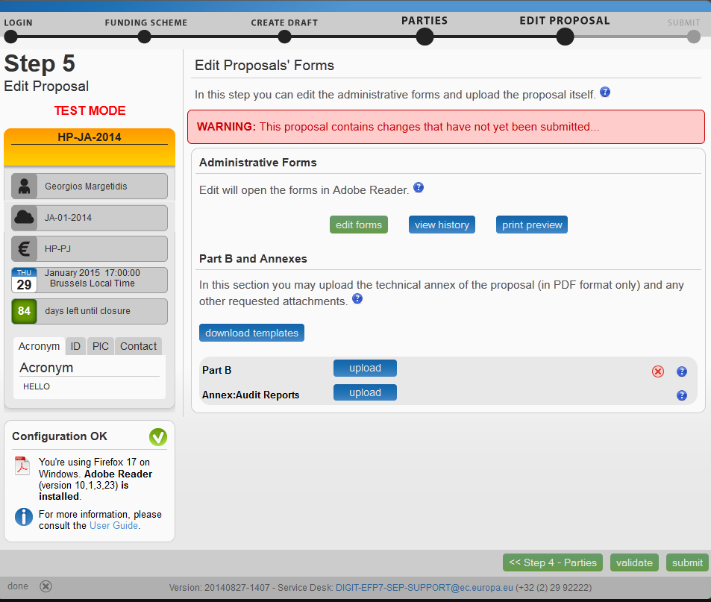
Next

Slide 20
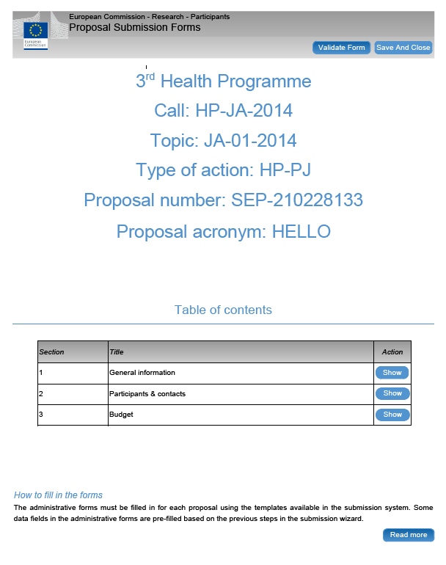
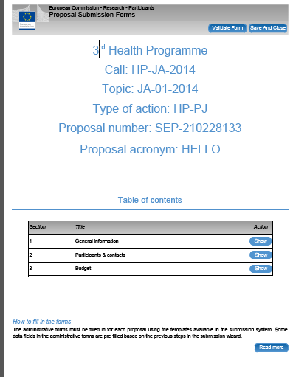

Slide 21
Part A or administrative part
Administrative information for each partner
Statements to be accepted e.g. on exclusion criteria, operational capacity, financial viability, etc.
Overview budget per partner – need to establish this before filling part A!

Slide 22
Part B or Technical Part
80 pages – free text & tables & charts
50 pages for the technical description
30 pages for the budget tables
One table per partner
Overview table with person months per deliverable

Slide 23
Key elements for a good proposal
Completeness: check that your intended proposal includes all relevant information.
Follow closely the format of the template of Part B and ensure that all the requested information is uploaded.
Avoid mixing quality with quantity: it is not about the number of pages.

Slide 24
Key elements for a good proposal
Management quality: clearly indicate the ability for high-quality management adapted to the scope of the intended activities of the organisation. Good financial management is a key component of management quality and adequacy between activities and requested budget is important.

Slide 25
Key elements for a good proposal
Orientation towards results and impact: good proposals clearly show the results that will be achieved, and how the participants intend to disseminate and/or use these results.
Good proposals include a sound and credible evaluation plan, not only focusing on process evaluation, but looking in particular at outcomes.
Includes work packages that tackle policies and national implementation!

Slide 26
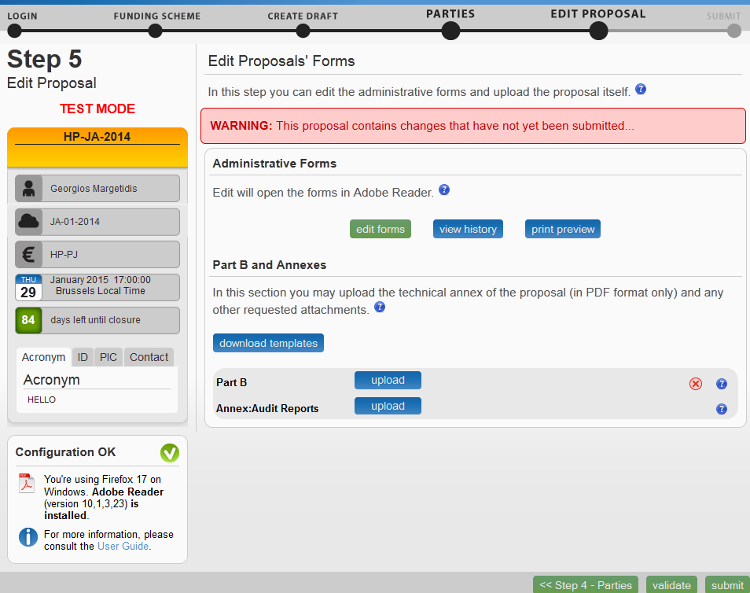
Upload Part B

Slide 27
Electronic Grant preparation
Grant preparation online ("back & forth" principle between Agency and beneficiaries).
Electronic signature by LEAR (Legal Entity Authorised Representative) – no paper copies of grant agreement.
Partners join the agreement after signature.
Monitoring and reporting online:
Deliverables, Payment requests, Reports, etc.

Slide 28
Thank you very much for your attention!
Any questions?
http://ec.europa.eu/chafea/health/index.html

